Slide 1

ROOF FEDERATION
PROJECT -- “Breath for life”

Slide 2

INTRODUCTION
Founded in 2022, Roof Federation was born from the vision of a young social entrepreneur NIKHIL TYAGI who brought together a group of passionate, like-minded individuals committed to PROVIDE SUSTANIBILITY GOALS.
Restoring and cleaning waste water through bio-remedies and eco-friendly techniques, ensuring safe water for people and communities. To Fulfil his dream of providing sustainability goals. Nikhil Tyagi has been associated with the cause since 2017.
We work with a clear purpose: to build a society where every child receives food and education, where women are empowered to lead independent, dignified lives.
We work to make quality healthcare accessible through initiatives focused on prevention, awareness, and medical support by Initiating project “ BREATH FOR LIFE”
Promoting sustainable practices, spreading awareness, and taking action to protect nature and build a healthier planet.
Restoring and cleaning waste water through bio-remedies and eco-friendly techniques, ensuring safe water for people and communities.

Slide 3


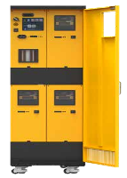



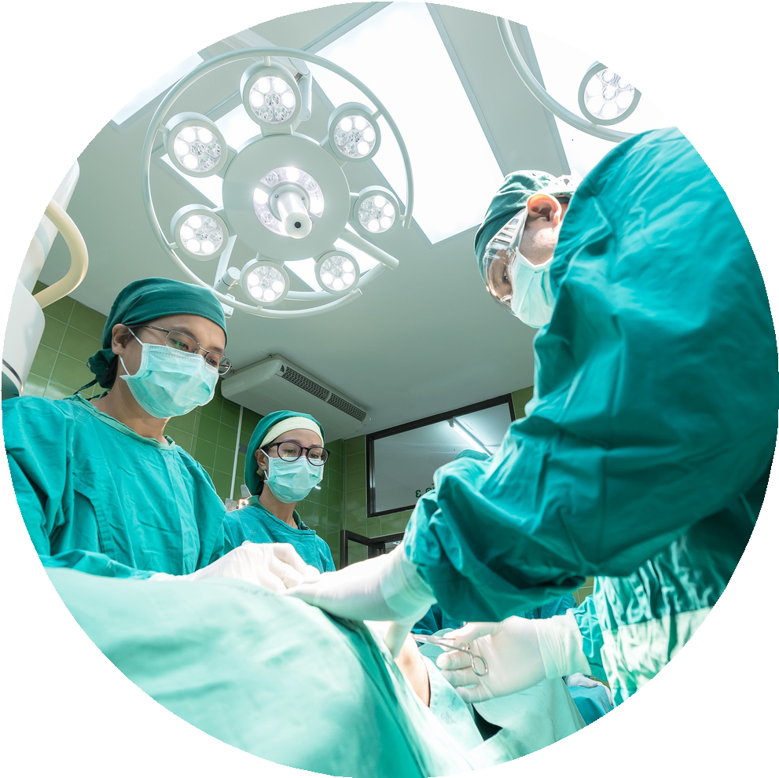
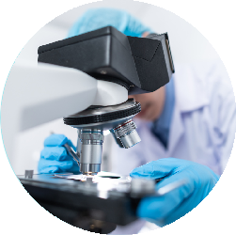

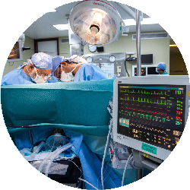
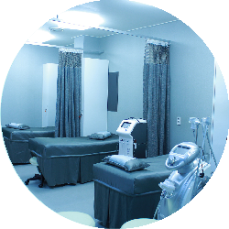
NEW GENERATION RAK OXYGEN UNIT
New Generation RAK
Oxygen Unit for Hospitals Works like high
Powered Concentrator
We Provide the Post Innovative Product.
Cost of Oxygen Gas Only INR 5 / M3**
Maximum Safety
Single Phase
Lowest Footprint
Solar Compatible
Subsidy Available
OXYGEN SUPPLY
PRODUUCT SAFFETY
MAINTENANCE DIFFERENTIATION
•Built-in booster(compressor
Even if one unit fails the equipment does
not have to turn off.
•Low pressure alarm function.
•Power pressure alarm function.
•The product warns automatically when
pressure reaches 6.5 bar.

Slide 4

WHY RAK ?
Procurement of Oxygen Cylinders : Small Hospitals always find it difficult procurement of oxygen gas cylinders. These cylinders may not be the right quality ( untested , unauthorized , underfilled, low purity, unsafe etc.)
Cost of procurement : On higher side ( Rs 250 to Rs 1000 per Cylinders ) procurement is a waste of time of staff for follow-up / billing/accounting / payments and malpractices etc.
Safety : Many hospitals do not have the right management team for cylinder handling. They struggle to keep the right SOP for Cylinder handling and storage leading to safety concerns. Many incidents have occurred where oxygen cylinders burst. RAK modular oxygen generators having a combination of 10 LPM units and a two-unit booster for raising pressure up to 6.5 bar ( one working and one stand-by).
USP: Standard plants in India have a single unit (if fails total output stops) but with OXUS RAK if one unit fails other five or two are working.
Installation: Simple Plug and play.
Lowest Footprint: Available plants need 4 meters by 4 meters. where has RAK is the size of a refrigerator.
Fast Return on Investment: Typical ROIs in 12 – 24 Months.

Slide 5
WHY RAK ?
Oxygen flow capacities : 30 LPM OR 60 LPM, can be increased as per requirement.
Oxygen discharge : Pressures up to 6 bar maximum OXYGEN SUPPLY.
WE PROVIDE THE MOST INNOVATIVE PRODUCTS •The product warns automatically when pressure reaches 6.5 bar. Even if one unit fails the equipment does not have to turn off.
WHY RAK? **ONLY INR 5 / M3**
MAXIMUM SAFETY SINGLE PHASE SOLAR COMPATIBLE *case to case basis WORKS LIKE A HIGH POWERED CONCETRATOR RAK.

Slide 6

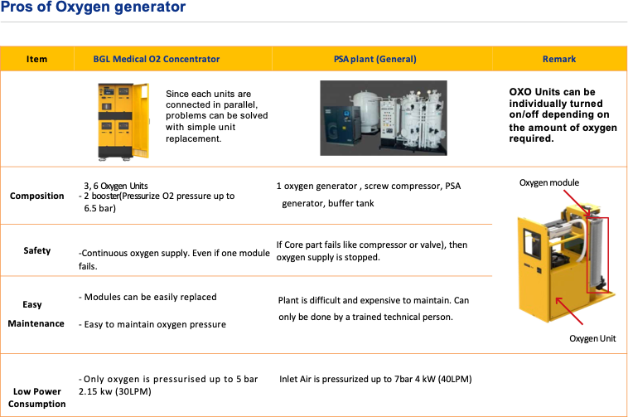

Slide 7
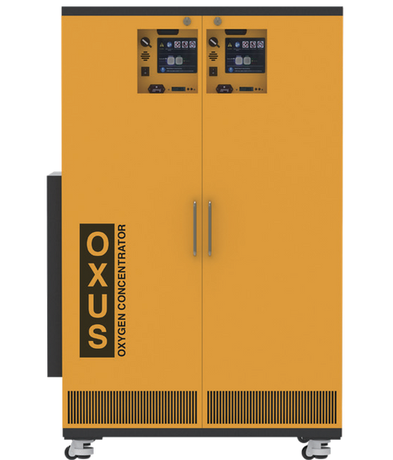


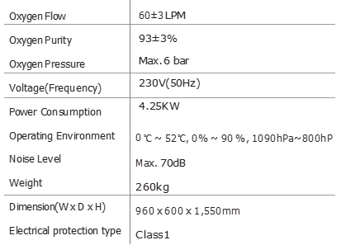
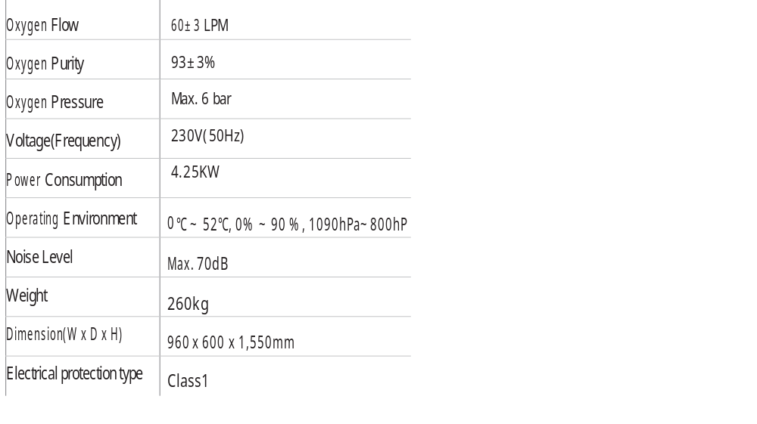
RAK-60 CAN BE SCALED UP TO ANY SIZE RAK-30
RAK-U06M2E
RAK-U03M2E
12 cylinders
6 cylinders
1 Day
1 Day
Total production in one day: 86,400L Gas oxygen (As for 40L, 120bar): 12 cylinders - TYPE D
Total production in one day: 43,200L Gas oxygen (As for 40L, 120bar): 6 cylinders - TYPE D
Total production in one day: 43,200L Gas oxygen (As for 40L, 120bar): 6 cylinders - TYPE D

Slide 8

THANK YOU

